Slide 1


Embedded AVR
Workshop
Session
3

Slide 2
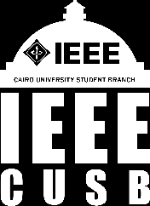


Hello!
Instructor: Marwan Alaa.
Cairo University
Contact me: marwan3laaosman@gmail.com
LinkedIn: https://www.linkedin.com/in/Marwan-alaa-4a630b2a3

Slide 3
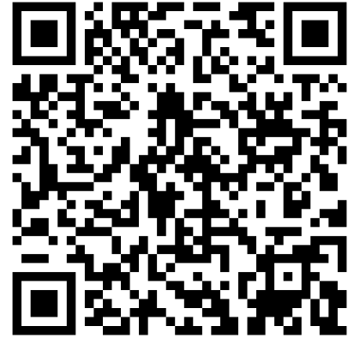

Slide 4
Content
Structs
Functions
Pointers
Pointers with functions
Arrays
Outputs/Inputs
Macros (#define, #if)
Header Files
Header Guards

Slide 5

03
C Programming Language Basics(Part2)

Slide 6


3.1- Structs
What is a Struct ?

Slide 7

3.1- Structs
A short-term for structure. It’s a data type that allows you to group variables together → to create a new data type

Slide 8
3.1- Structs
Declaring a struct:
struct StructureName {
dataType variable1; datatype variable2;
};
Creating a struct variable:
struct StructureName variableName;

Slide 9
3.1- Structs
Declaring a struct: (Another syntax more common)
typedef struct { dataType variable1; datatype variable2;
} StructureName;
Creating a struct variable:
int main() {
(no need for writing struct) StructureName variableName;
return 0;
}

Slide 10
3.1- Structs
#include <stdio.h>
typedef struct {
int id;
char name[20];
float grade;
float average;
} Student;
int main() {
Student student1 = { 20240567, "Marwan", 85.6, 0.0 };
student1.average = 68;
Return 0;
}

Slide 11
3.2- Functions
A block of code that performs a specific task. It’s a reusable piece of code that runs only when called → to prevent repetition, provide readability and reusability
Void Function Return Function
Does NOT return any value
to the caller.
It does operations or print sth
,but not returning a value like an
Integer or a character to use it
After.
Does return any value
to the caller.

Slide 12
Syntax (Void Functions):
returnType functionName(parameters) {
// Code to execute
return value; // (if return Type is not void)
}
Example:
void Passing(int grade, float average) {
if (grade >= average)
printf("You have passed!\n");
else
printf("You have failed!\n");
}

Slide 13
int main() {
int grade;
float average;
Passing(grade, average); // Function call
}
Syntax (Return Functions):
returnType functionName(parameters) {
// Code to execute
return value; // (if return Type is not void)
}

Slide 14
int add(int a, int b){
int sum = a + b;
return sum; // return value to caller
}
Example:
int main() {
int result;
result = add(5, 3); // function call
printf("Sum = %d\n", result);
}

Slide 15
3.2- Functions
Without Function (Repeated Code):
#include <stdio.h>
int main() {
int p1 = 100;
int p2 = 250;
int p3 = 400;
int total1 = p1 + (p1 * 14 / 100);
int total2 = p2 + (p2 * 14 / 100);
int total3 = p3 + (p3 * 14 / 100);

Slide 16
3.2- Functions
printf("Total 1 = %d\n", total1);
printf("Total 2 = %d\n", total2);
printf("Total 3 = %d\n", total3);
return 0;
}

Slide 17
3.2- Functions
With Function (Clean Code):
int calculateTotal(int price){
return price + (price * 14 / 100);
}
int main(){
int p1 = 100;
int p2 = 250;
int p3 = 400;
printf("Total 1 = %d\n", calculateTotal(p1));
printf("Total 2 = %d\n", calculateTotal(p2));
printf("Total 3 = %d\n", calculateTotal(p3));
}

Slide 18
3.3- Pointers
Pointer is a variable that stores the memory address of another variable. It “points” to where data is stored in memory
Asterisk (*) Used to declare a pointer variable int x = 42; // x = 42
int *ptr; // * means "ptr is a pointer to an int"
Ampersand (&) gets the address of a variable
ptr = &x; // & gets x's address, stores it in ptr
int value = *ptr; // * gets the value at address ptr (42) *ptr = 100; // * changes value at address ptr to 100

Slide 19
3.3- Pointers
int main(){
int x = 10; // normal variable
int* ptr; // pointer to int (just defining a pointer
to point an address of another variable)
ptr = &x; // store address of x in ptr
printf("Value of x: %d\n", x); // 10
printf("Address of x: %p\n", &x); // memory address
printf("Value via pointer: %d\n", *ptr); // 10
*ptr = 20; // change x using pointer
printf("New value of x: %d\n", x); // 20
}

Slide 20
3.4- Pointers with Functions
// Function to swap two integers
void swap(int* a, int* b){
int temp = *a;
*a = *b;
*b = temp;
}

Slide 21
3.4- Pointers with Functions
int main(){
int x = 10, y = 20;
printf("Before swap: x = %d, y = %d\n", x, y);
swap(&x, &y); // pass addresses of x and y
printf("After swap: x = %d, y = %d\n", x, y); // Output: After swap: x = 20, y = 10
Return 0;
}

Slide 22

3.5- Arrays
Array is a data type that consist of a collection of elements of the same data type stored in contiguous memory locations.
The array name itself is a pointer to the first element
Strings in C = character of arrays + null terminator

Slide 23
3.5- Arrays
int main() {
int numbers[5] = { 10, 20, 30, 40, 50 };
// The name 'numbers' is a pointer to the first element
int* ptr = numbers;
// Accessing elements via the pointer
printf("First element: %d\n", *ptr); // prints 10
printf("Second element: %d\n", *(ptr + 1)); // prints 20
printf("Third element: %d\n", ptr[2]); // prints 30
}

Slide 24
3.6- Outputs
Syntax:
printf();
But in C we use specifiers to detect the variable’s data type.

Slide 25
3.6- Outputs
Specifiers
Data Type | Specifier
int | %d
char | %c
string | %s
float | %f
Pointer (any type) | %p
long | %ld
short | %hd

Slide 26
3.6- Outputs
#include <stdio.h>
int main() {
int i = 42;
unsigned int u = 300;
float f = 3.14;
double d = 2.718281828;
char c = 'A';
char str[] = "Hello, C!";
int* ptr = &i;

Slide 27
3.6- Outputs
// Printing different types
printf("Integer: %d\n", i);
printf("Unsigned Integer: %u\n", u);
printf("Float: %f\n", f);
printf("Double: %lf\n", d);
printf("Character: %c\n", c);
printf("String: %s\n", str);
printf("Pointer (address of i): %p\n", (void*)ptr);
return 0;
}

Slide 28
3.7- Inputs
When you type something (input) on the keyboard, the data does not go directly
to your program’s variable.
It first goes to a temporary holding area called the input buffer.
So inputs in C read the value from the buffer then it stores it in the variable
Address
So, we use & because we store in the address of the variable, with all data
Types except with strings (because they are arrays and array name already
acts as a pointer to its first element.)

Slide 29
3.7- Inputs
int main() {
int num;
printf("Enter a number: ");
scanf("%d", &num); // Reads from the buffer and stores in 'num'
printf("You entered: %d\n", num);
return 0;
}

Slide 30
3.8- Macros
A macro is a text substitution done by the preprocessor before compilation.
Macros are not variables — they don’t consume memory.
The preprocessor is a program that runs before the compiler. Its job is to prepare your code for compilation by handling directives like #include, #define, #ifdef, etc.
So, we use it with CONST variables

Slide 31
3.8- Macros
A macro is a text substitution done by the preprocessor before compilation.
Constants (most common use)
Doesn’t consume the memory as the value is not stored anywhere. It is written directly inside the machine instruction itself.

Slide 32
3.8- Macros
#include <stdio.h>
#define PI 3.14159 // simple macro without parameters
#define SQUARE(x) ((x)*(x)) // macro with parameter
int main() {
float radius = 5.0;
float area = PI * SQUARE(radius);
printf("Area = %f\n", area);
return 0;
}

Slide 33
3.8- Macros
① Preprocessing Handles #define, #include, #ifdef Text substitution only (like in the pic) ② Compilation converts C → assembly ③ Assembly converts assembly → machine code ④ Linking combines object files

Slide 34
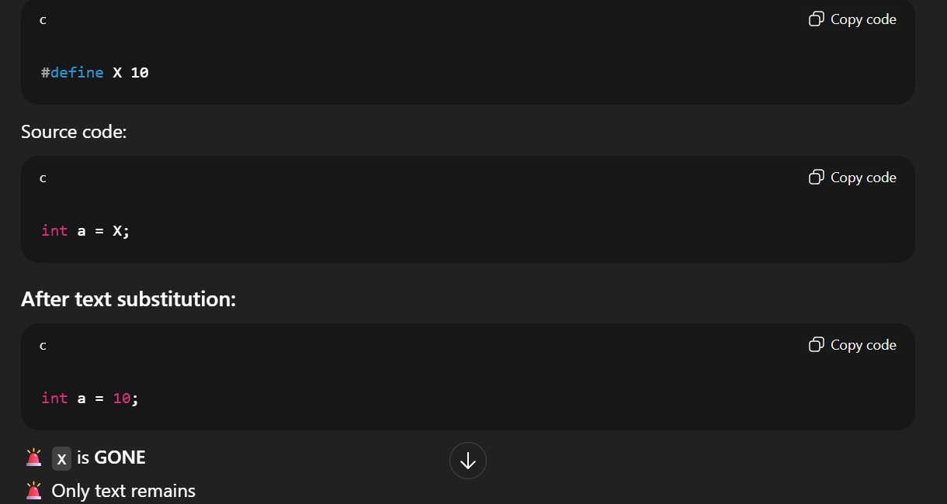
3.8- Macros

Slide 35
3.9- Header Files
A header file is for declaring functions and macros, specifically those that should be shared between source files.
A header file is a file with extension .h that contains declarations and Macros.
And we add this header file in the source file (main file).
// Header File
#define PI 3.14159
int square(int x);
float circle_area(float radius);

Slide 36
3.9- Header Files
// Source File
#include <stdio.h>
#include "math_utils.h" // include your custom header
int main() {
int a = 5;
printf("Square: %d\n", square(a));
printf("Circle area: %f\n", circle_area(a));
return 0;
}

Slide 37
3.9- Header Files
How Compiler Read this previous File??
#include "math_utils.h“ >> it substitute this line with the header file code to look like this

Slide 38
3.9- Header Files
#include <stdio.h>
int main() {
int a = 5;
printf("Square: %d\n", square(a));
printf("Circle area: %f\n", circle_area(a));
return 0;
}
#define PI 3.14159
int square(int x);
float circle_area(float radius);

Slide 39
3.10- Header Guards
The problem of headers that when we include many header files >> it would make the compiler do more definition for the same file more than once.
// file1.h
#define VALUE 100
int square(int x) {
return x * x;
}

Slide 40
3.10- Header Guards
// file2.h
#include "file1.h"
int cube(int x) {
return x * x * x;
}
// main.c
#include <stdio.h>
#include "file1.h"
#include "file2.h"
int main() {
printf("Square of 5: %d\n", square(5));
printf("Cube of 3: %d\n", cube(3));
printf("Value: %d\n", VALUE);
}

Slide 41
3.10- Header Guards
How will it be read??
// main.c
#include <stdio.h>
#define VALUE 100
int square(int x) {
return x * x;
}
int square(int x) {
return x * x;
}

Slide 42
3.10- Header Guards
int cube(int x) {
return x * x * x;
}
int main() {
printf("Square of 5: %d\n", square(5));
printf("Cube of 3: %d\n", cube(3));
printf("Value: %d\n", VALUE);
}
So, we find that we did define file1.h twice >> ERROR
It’s why we use Header Guards >> To define the file only one time

Slide 43
3.10- Header Guards
// file1.h
#ifndef FILE1_H // if file1 not defined
#define FILE1_H // then define file1
#define VALUE 100
int square(int x) {
return x * x;
}
#endif // END

Slide 44
3.10- Header Guards
// file2.h
#ifndef FILE2_H // if file2 not defined
#define FILE2_H // then define file2
#include "file1.h"
int cube(int x) {
return x * x * x;
}
#endif // END

Slide 45
3.10- Header Guards
// main.c (unchanged)
#include <stdio.h>
#include "file1.h"
#include "file2.h"
int main() {
printf("Square of 5: %d\n", square(5));
printf("Cube of 3: %d\n", cube(3));
printf("Value: %d\n", VALUE);
return 0;
}

Slide 46
Thanks!
Any Questions?

